Slide 1
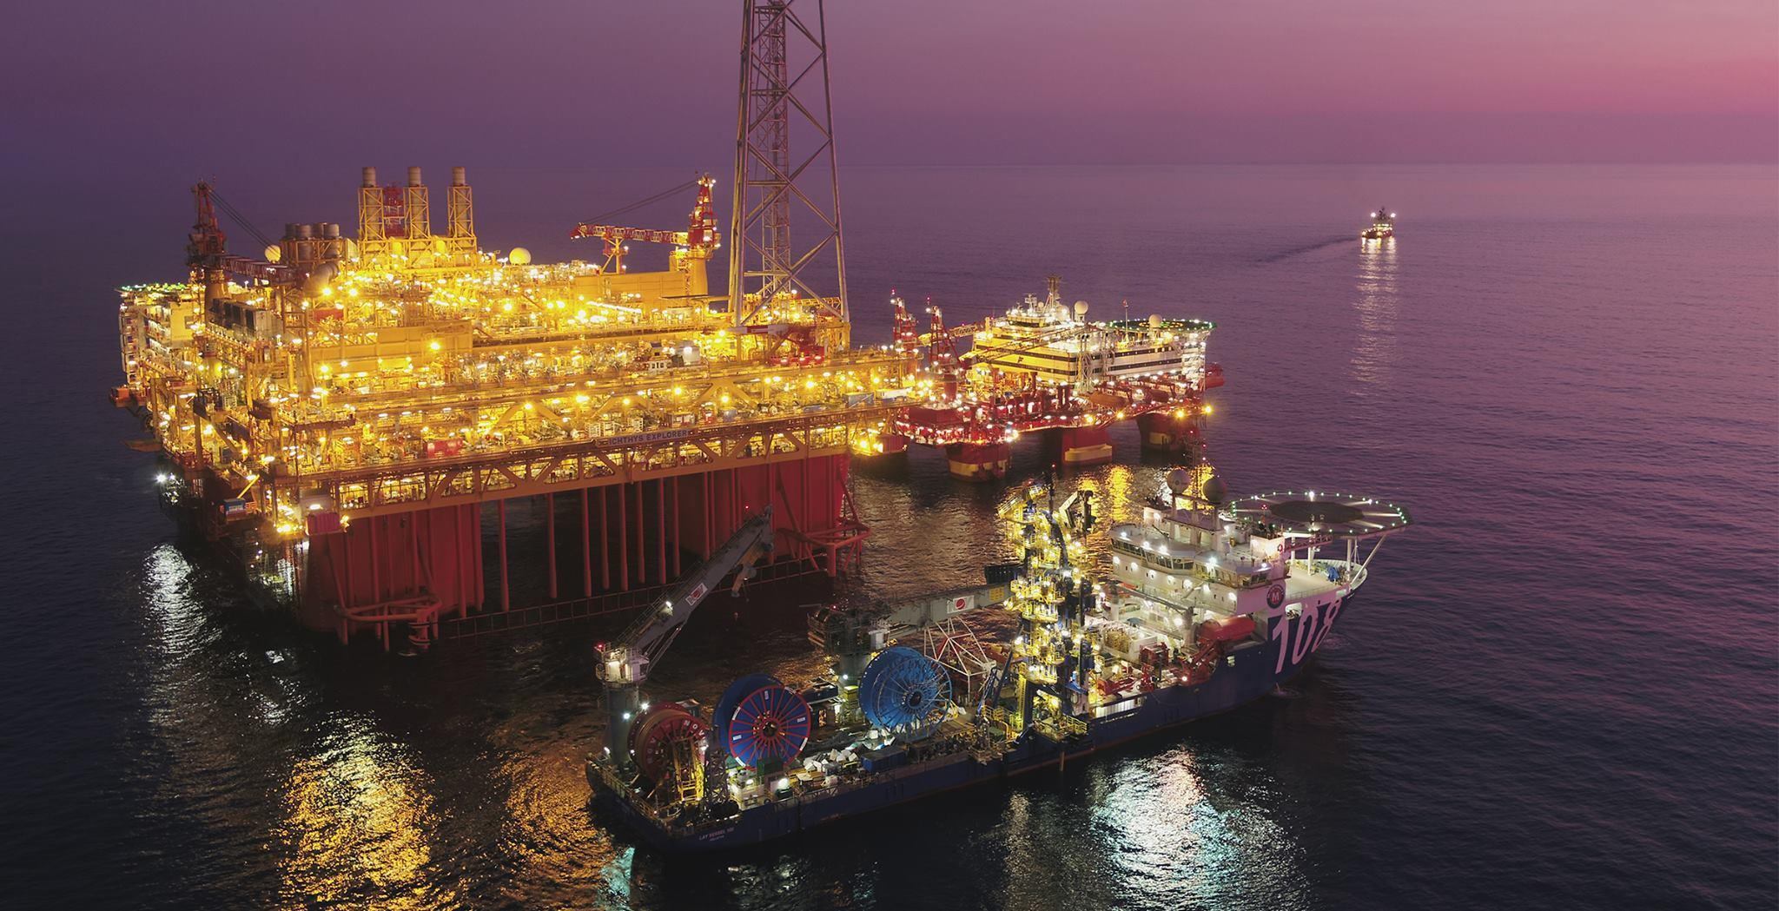


Winter Semester'23
GPC 510
Department of Applied Geophysics
WELL LOGGING
CASE STUDY
DEFINITION AND SCOPE OF WORK
(22MC0011) Aman Kumar
(22MC0011) Mahadeb Saha
(22MC0080) Sanjukta Singh
( 20JE0085) Akash Pratap Singh
Instructor: Dr. Partha Pratim Mondal

Slide 2

OUTLINES :
Design a gamma ray tool
Perform quality control and mark obvious outlier
Calculating total porosity from the density and neutron combination
Plotting velocity depth profile with respect to volume of cell
Calculating water saturation and generating reservoir flag
Reporting Φt, Sw, Vsh

Slide 3
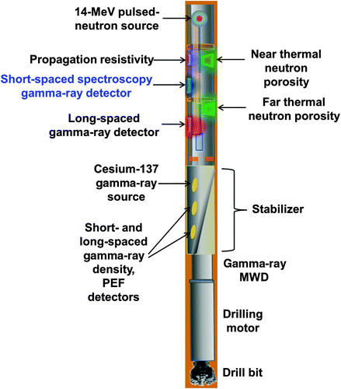
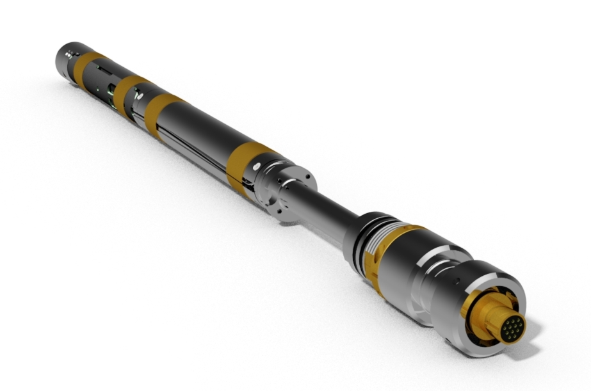
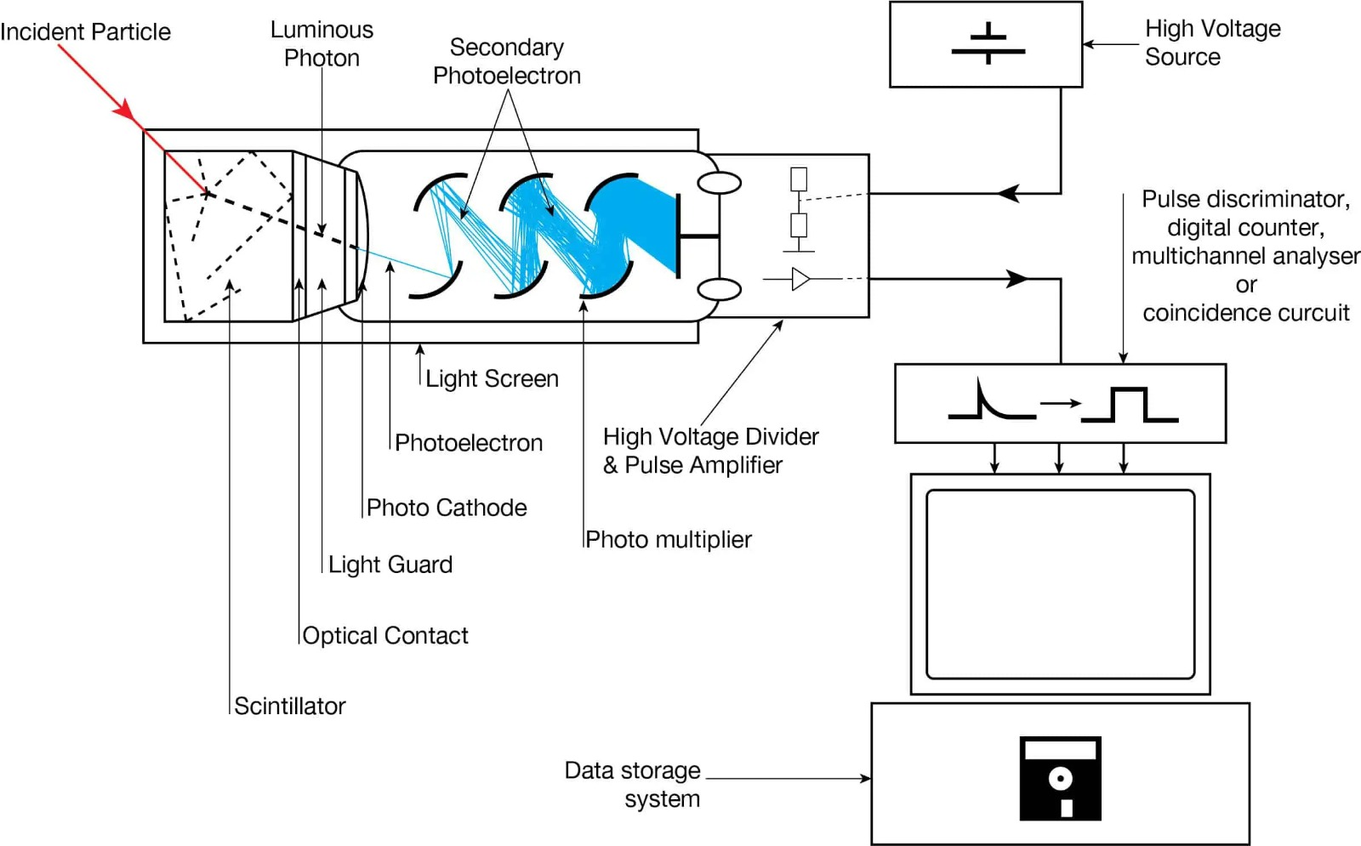
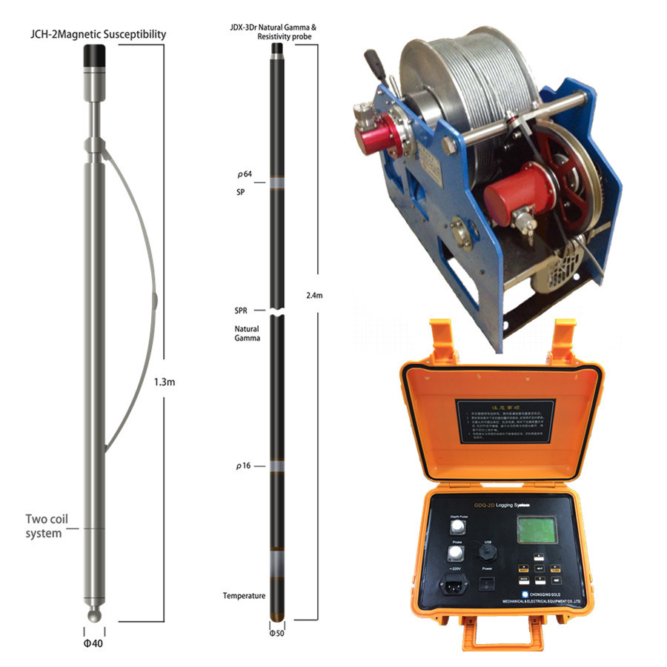






Designing a gamma ray tool
Gamma ray detector
Signal processing electronics
Logging cable
Surface equipment
Calibration Source
Radiation Shielding
Mechanical Components
Data Storage
Display

Slide 4
Quality Control :
What is Quality Control ?
Quality Control ensures that data is reliable and working perfectly fine and for ensuring that there are some process like-
Checking for consistency
Inspect for “SPIKES”
Identifying Marked outliers
Common Method for identifying outliers is to use statical techniques like pairplot, histogram plot etc.
STEPS:
Calibration
Data verification
Depth Matching
Outlier Detection
Quality Flags
Interpretation

Slide 5
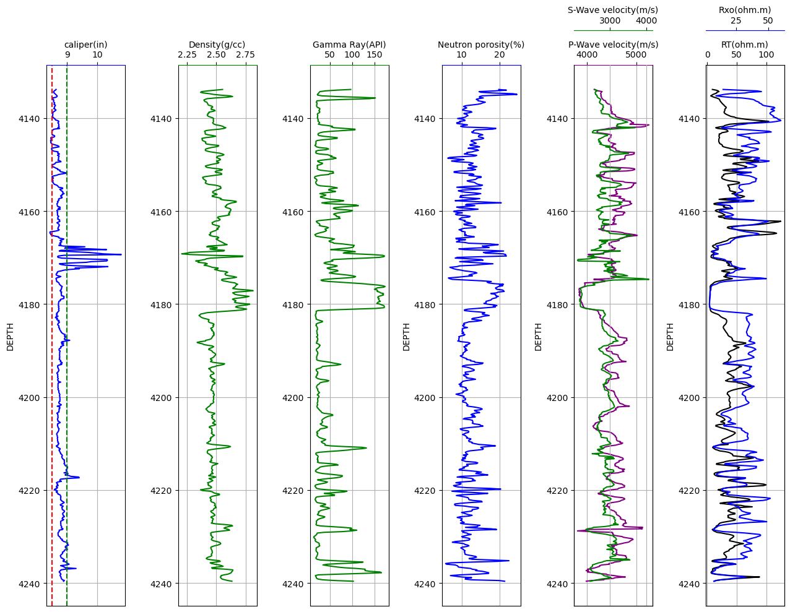
Logging tools :

Slide 6
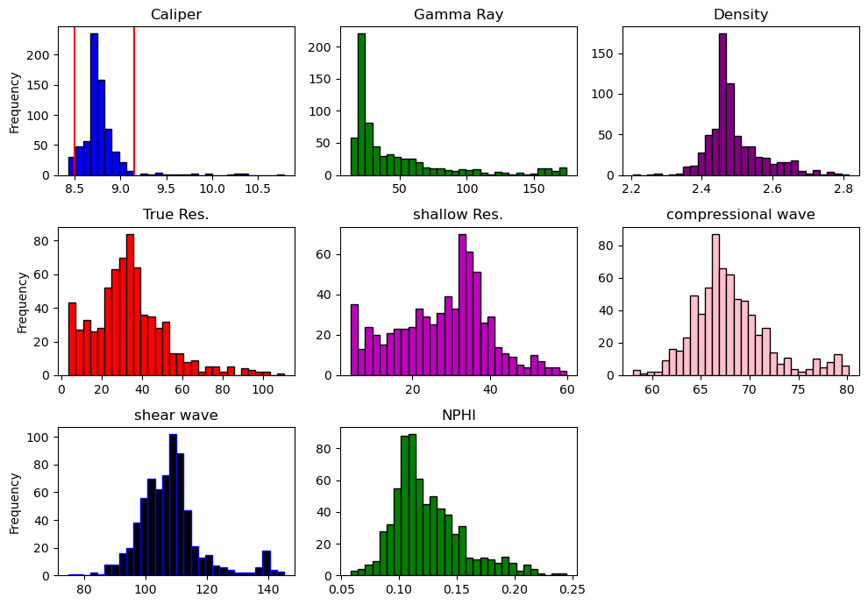
Marking outlier :
Marked Areas
represent outliers.

Slide 7
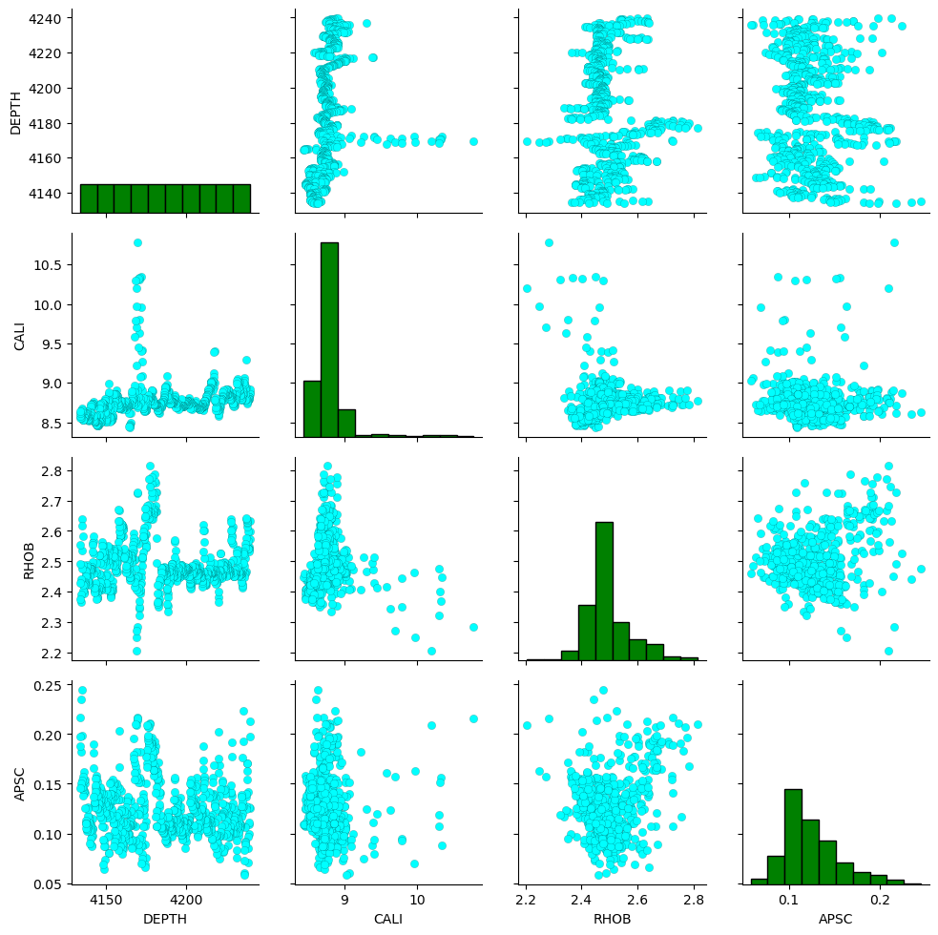
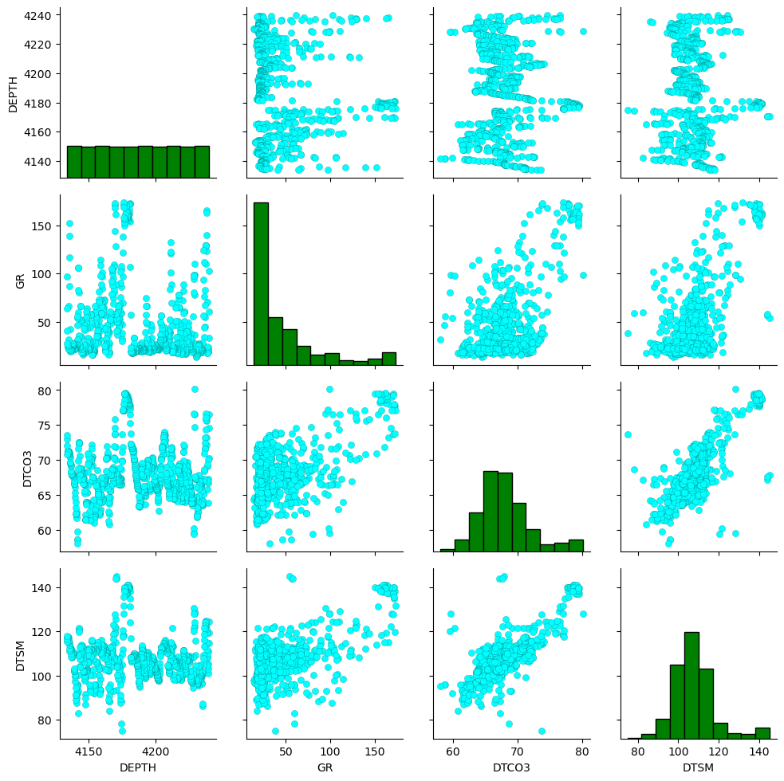
Pair-plots :

Slide 8
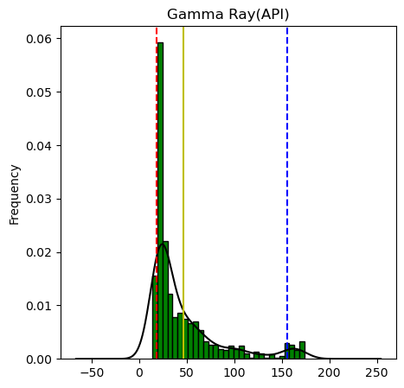
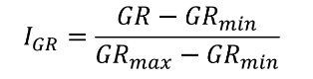
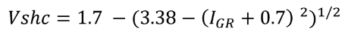
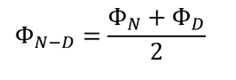
Calculating volume of shale and total porosity :
Formula to calculate volume of shale (also known as Gamma ray index) :
Sand line - - -
Shell line - - -
Correction for Younger sediments-Claiver
Formula to calculate total porosity
(in case of oil & brine)

Slide 9
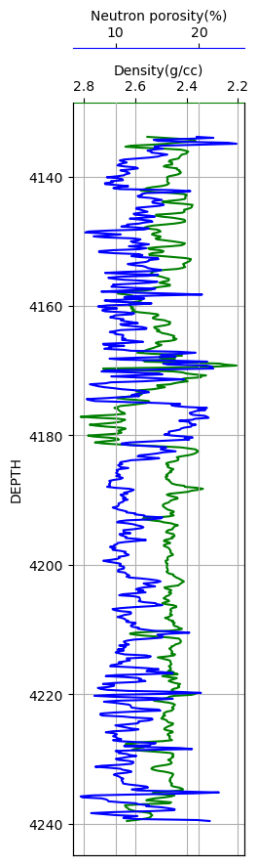
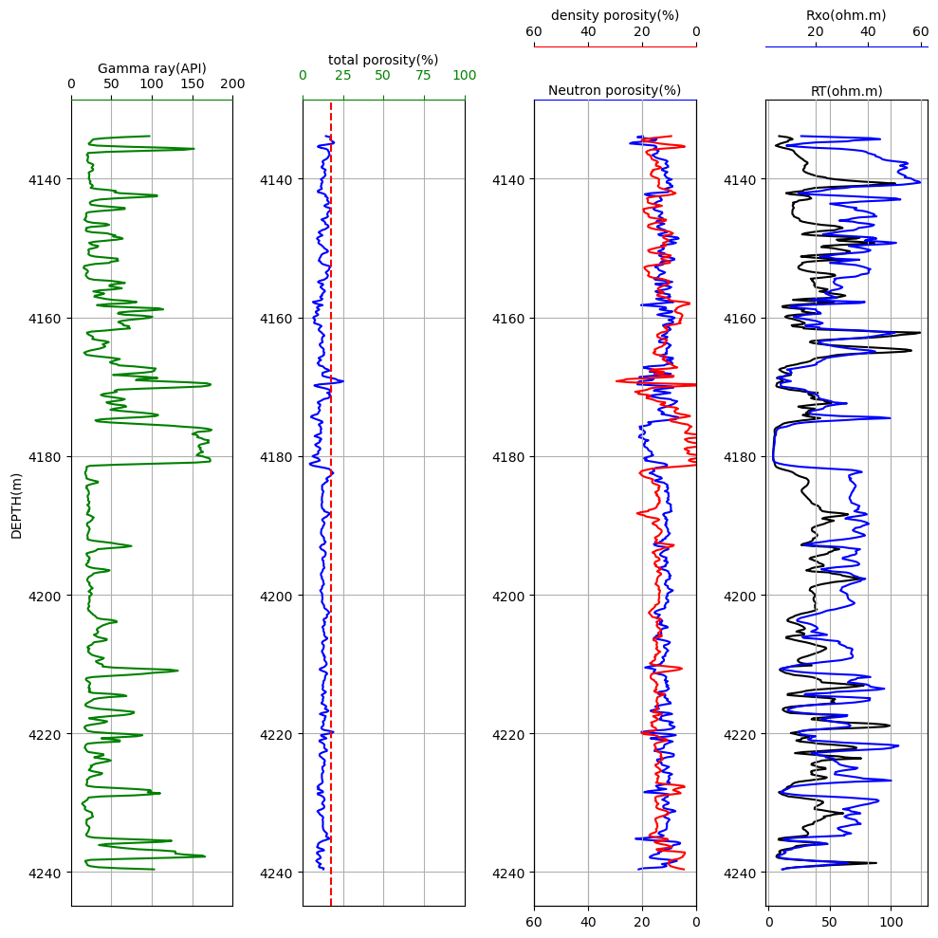
Marking the zone of high porosity:
Maximum porosity=17.5%
(- - - - -)
Mudstone

Slide 10
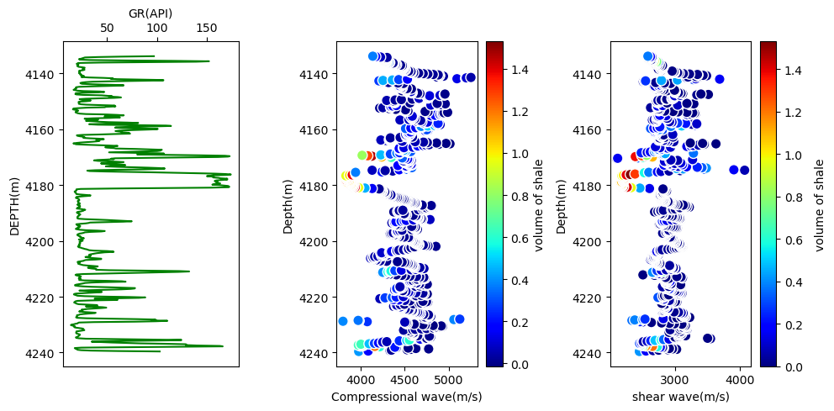
Velocity depth profile (with respect to volume of shale) :
Compressional wave:
Unconsolidated layer & weathering layer = low vel. zone

Slide 11
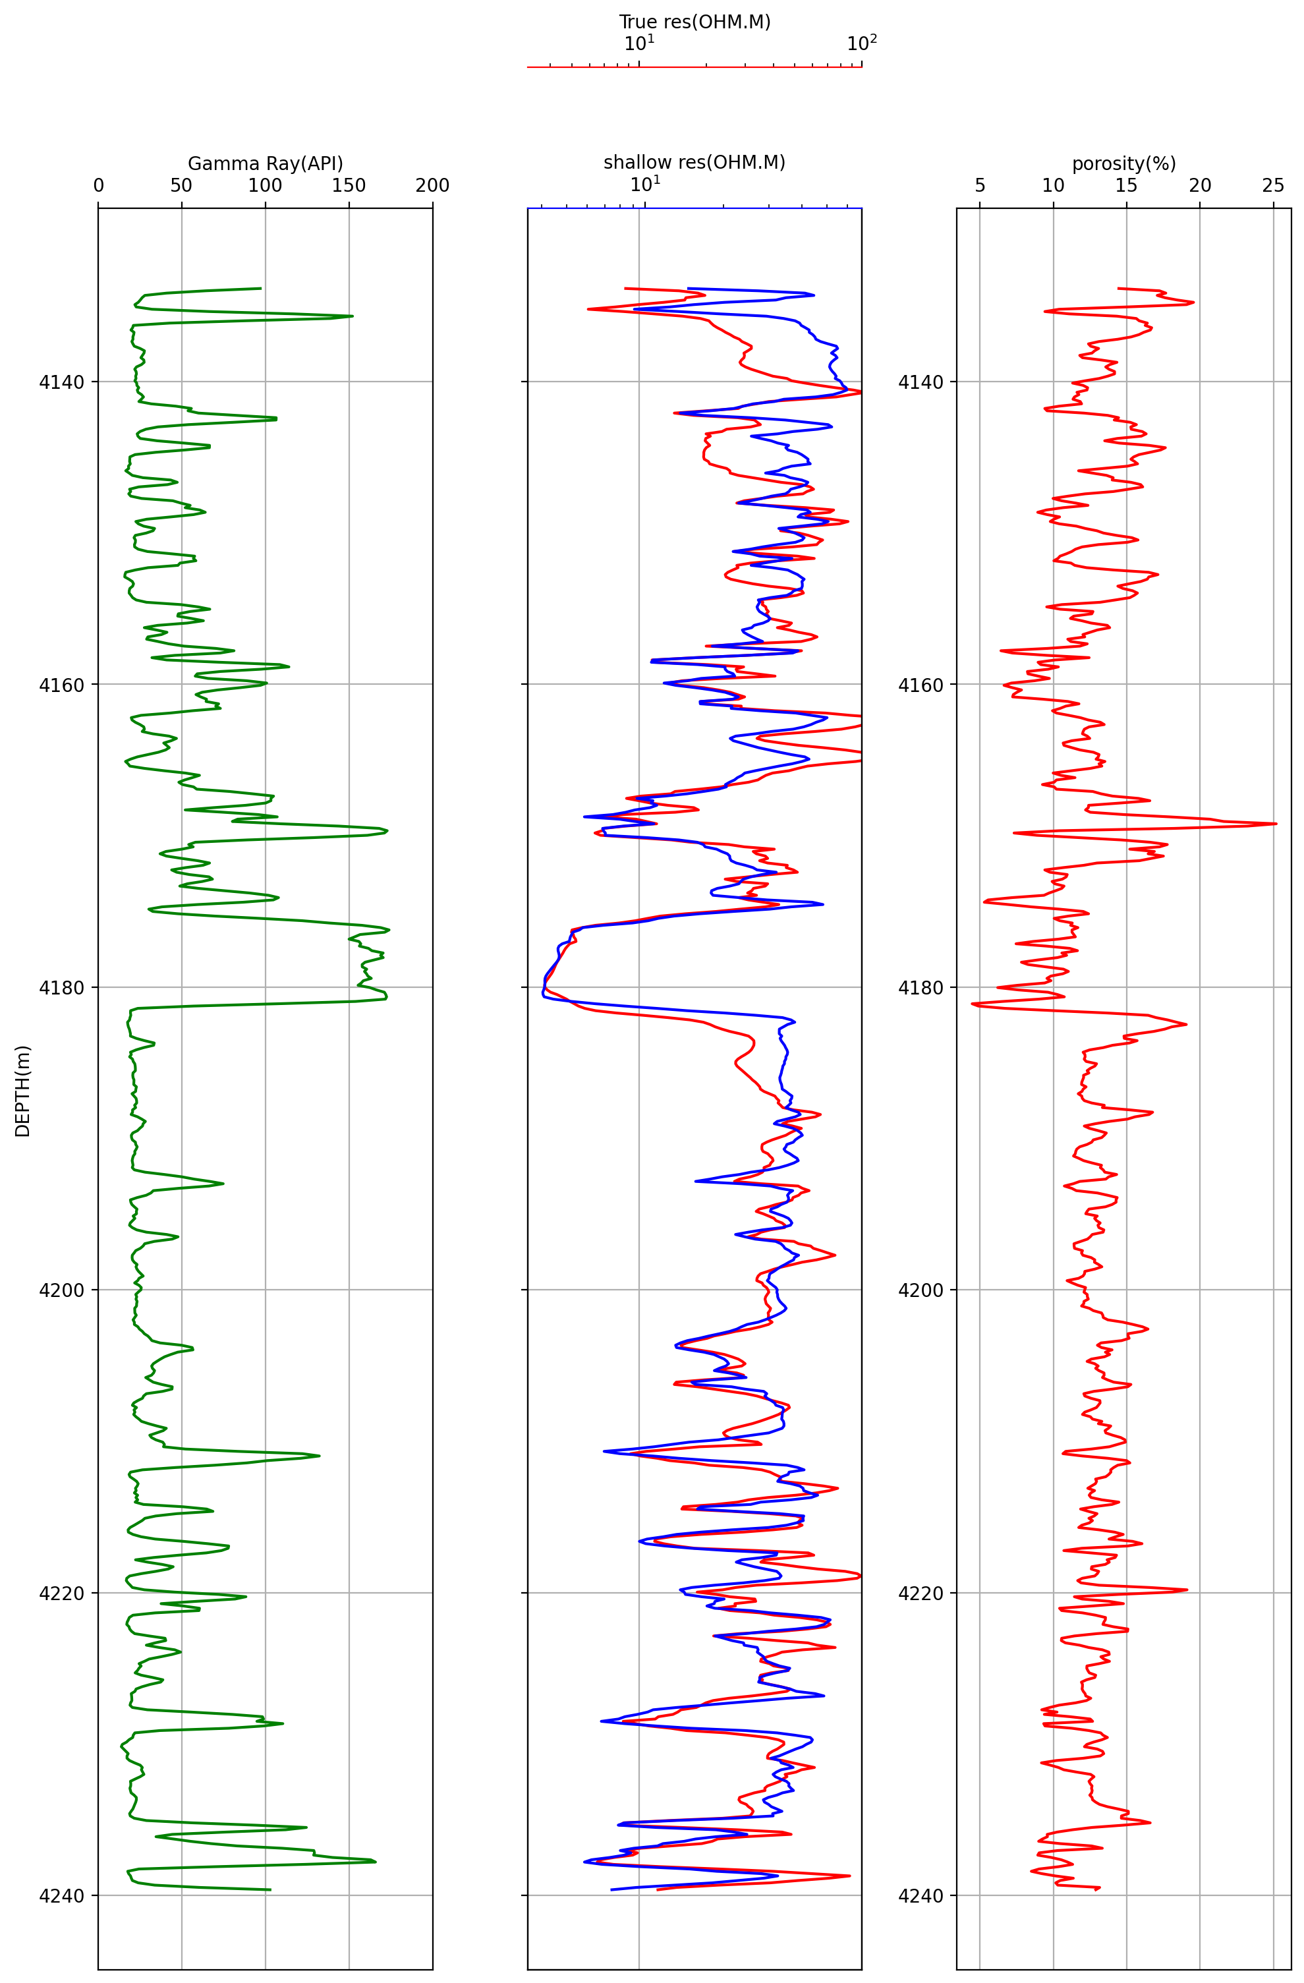
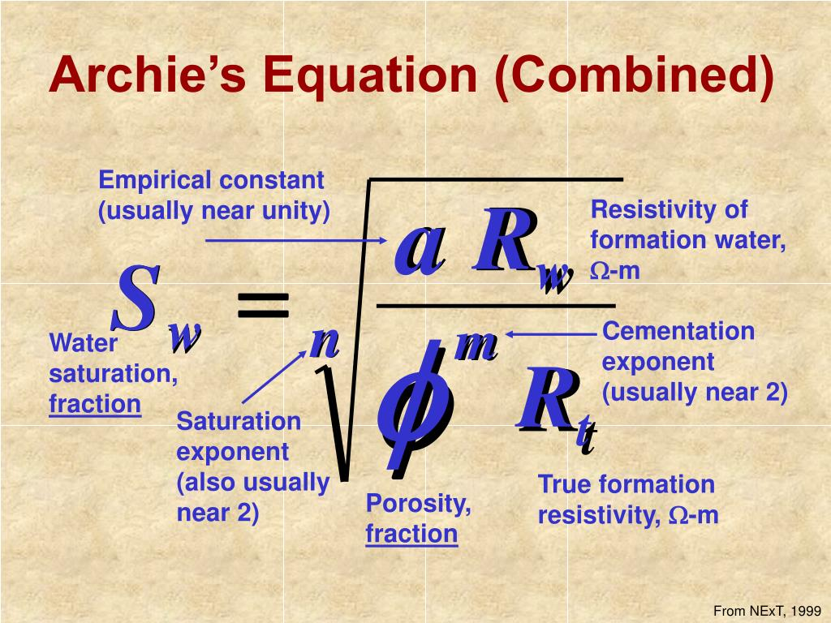

Calculating Rw by observation of log :
In the above, we take n=2, a=1, m=1
When Sw=1, n= 2 & a=1
By observation we get, Rw=0.4

Slide 12
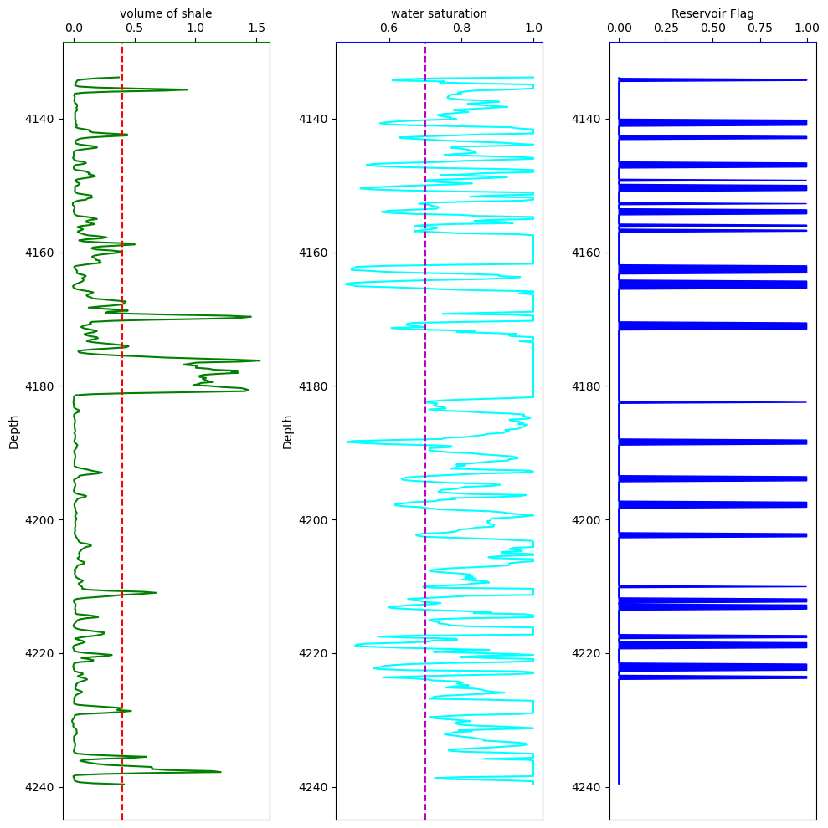
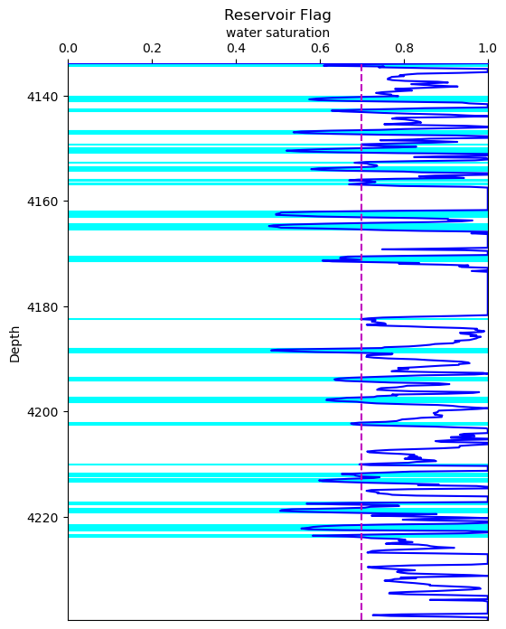
Flagging of Reservoir zone (Vsh ≤ 0.4, Sw ≤ 0.7) :

Slide 13
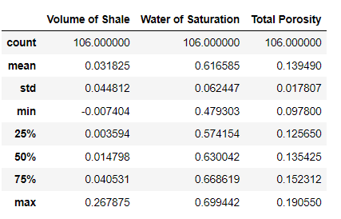
Reporting Φt, Sw, Vsh :
Standard Deviation:
For Vsh = 0.044812
Sw = 0.062447
Φt = 0.017807

Slide 14
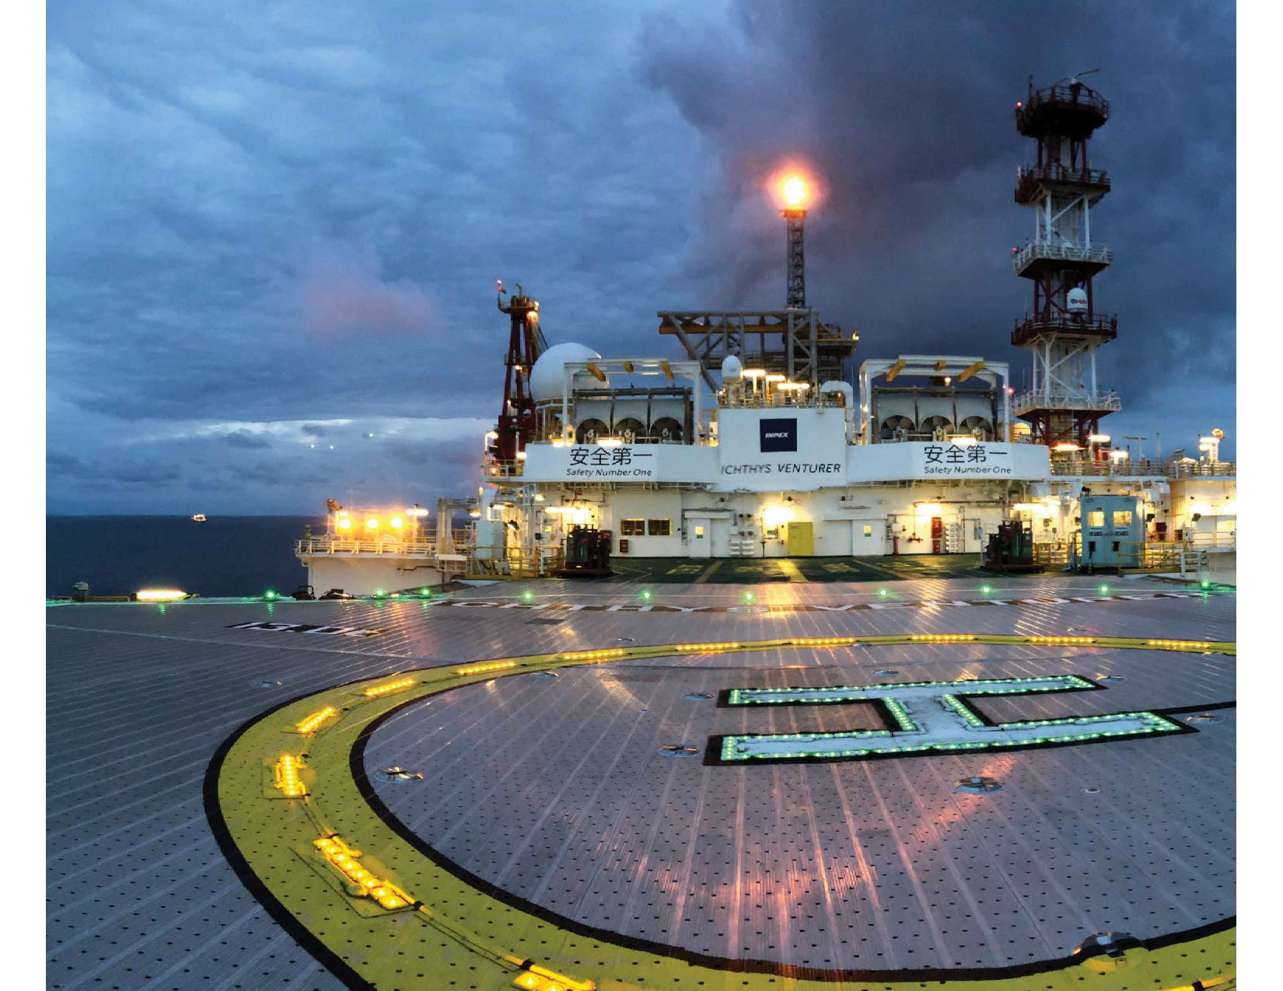
Thank You…

